Slide 1



HACKMERIDIAN 2026 · LISBON
PLATFORM 01 / 05
PITCH DECK · MADE TO MOVE
Sidekey
Your wallet is the master. Everyone else gets a policy.
October 2026
#HackMeridian26
© 2026 HackMeridian · Lisbon

Slide 2

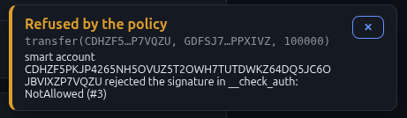
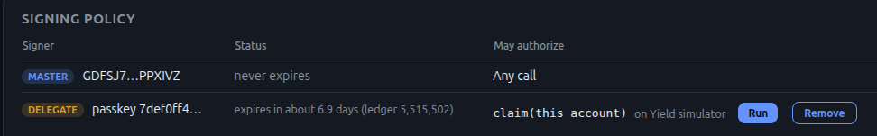

PLATFORM 02 / 05
HACKMERIDIAN 2026 · LISBON
NEXT ▸ PMF
PITCH STEP 01 / 04
Safe convenience
Keep it secret, keep it safe!
Your hardware wallet keeps your funds protected and safe
So why take it out every time you need to make a routine transaction?
With Sidekey, your hardware wallet can stay safely stored. You decide which interactions are allowed with just your phone.
Anyhing else? Not allowed!
You allowed it!
A passkey may call claim() on a yield emitting contract
Transfer? Not allowed!
© 2026 HackMeridian · Lisbon · #HackMeridian26

Slide 3
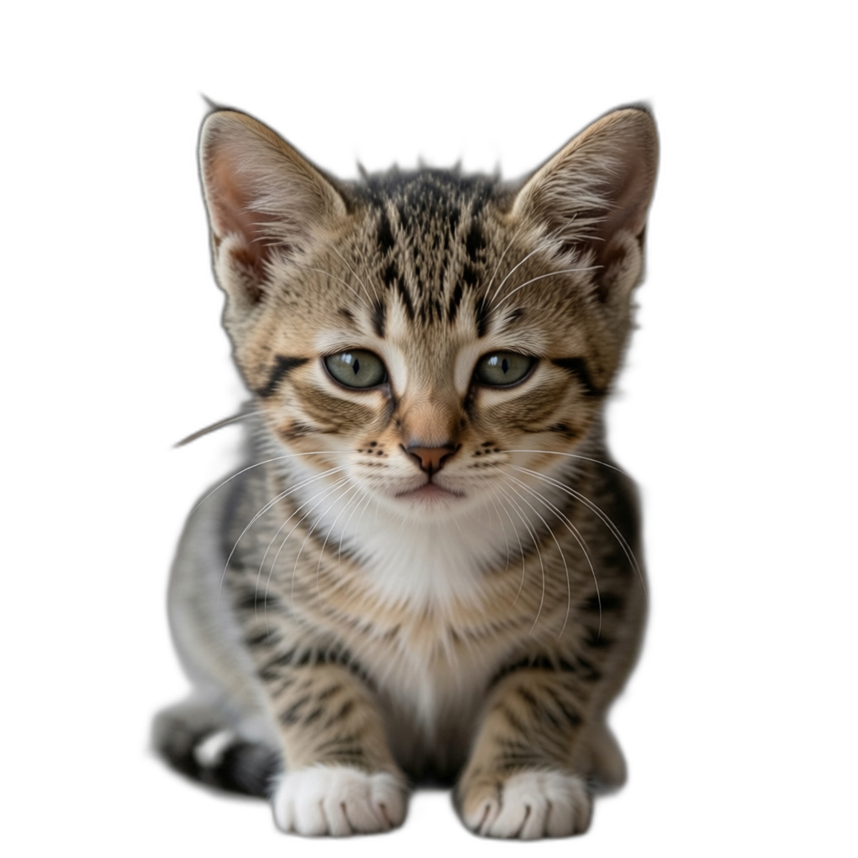
PLATFORM 03 / 05
HACKMERIDIAN 2026 · LISBON
NEXT ▸ TECHNICAL WORKFLOW
PITCH STEP 02 / 04
PMF
Every day, thousands of kittens are injured because people drop their hardware wallet on them during routine transactions..
Well, potentially. I didn’t research that. But it could be!
It solves an inconvenience, and promotes safety*
👉 Why you should care? Policy signers are in the spotlight with x402, but don’t neglect their potential for ‘human accounts’. It allows for convenience improvements like this, but can for example also limit how much you(r kids) can spend on silly games.
* Testnet demo implementation only. Do not use on mainnet. Do not use with real funds
© 2026 HackMeridian · Lisbon · #HackMeridian26

Slide 4
PLATFORM 04 / 05
HACKMERIDIAN 2026 · LISBON
NEXT ▸ THE TEAM
PITCH STEP 03 / 04
TECHNICAL WORKFLOW
Under the hood
Create a smart account, with your G.. account as master signer
Add passkey signers in policies that are explicit in which contract, function and arguments they can authorise
Anything not explicitly allowed still needs the full (hardware) G.. signer
(Ab)use wallets signMessage methods until AuthEntries can be signed by hardware-compatible wallets
© 2026 HackMeridian · Lisbon · #HackMeridian26

Slide 5
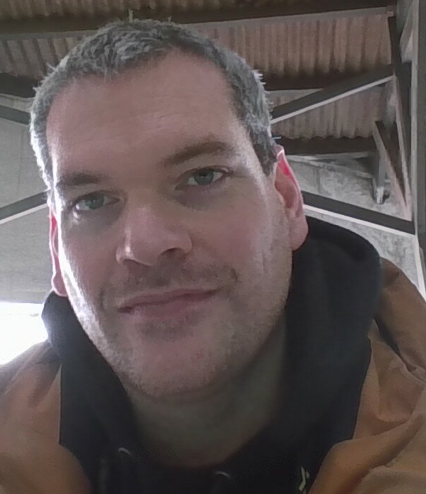
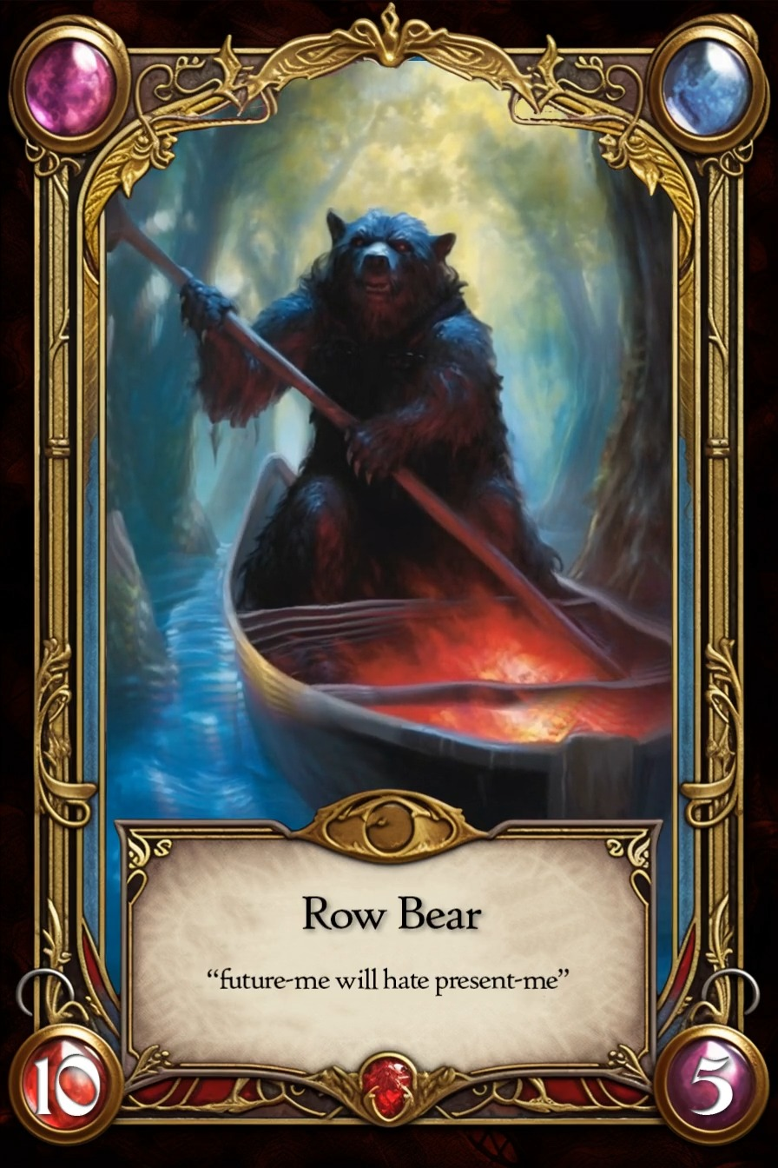

PLATFORM 05 / 05
HACKMERIDIAN 2026 · LISBON
FINAL STOP
PITCH STEP 04 / 04
Also Robert, the picture you usually see.
NO TEAM
Robert
Just me
Robert a.k.a Row-Bear
Stellar Quester, RPCieger, tinkerer, community member
No formal education or experience in development, but over the years I’ve picked up enough to make and break some things
Github Copilot did most of the legwork really
👉 This was great fun
© 2026 HackMeridian · Lisbon · #HackMeridian26

